Slide 1
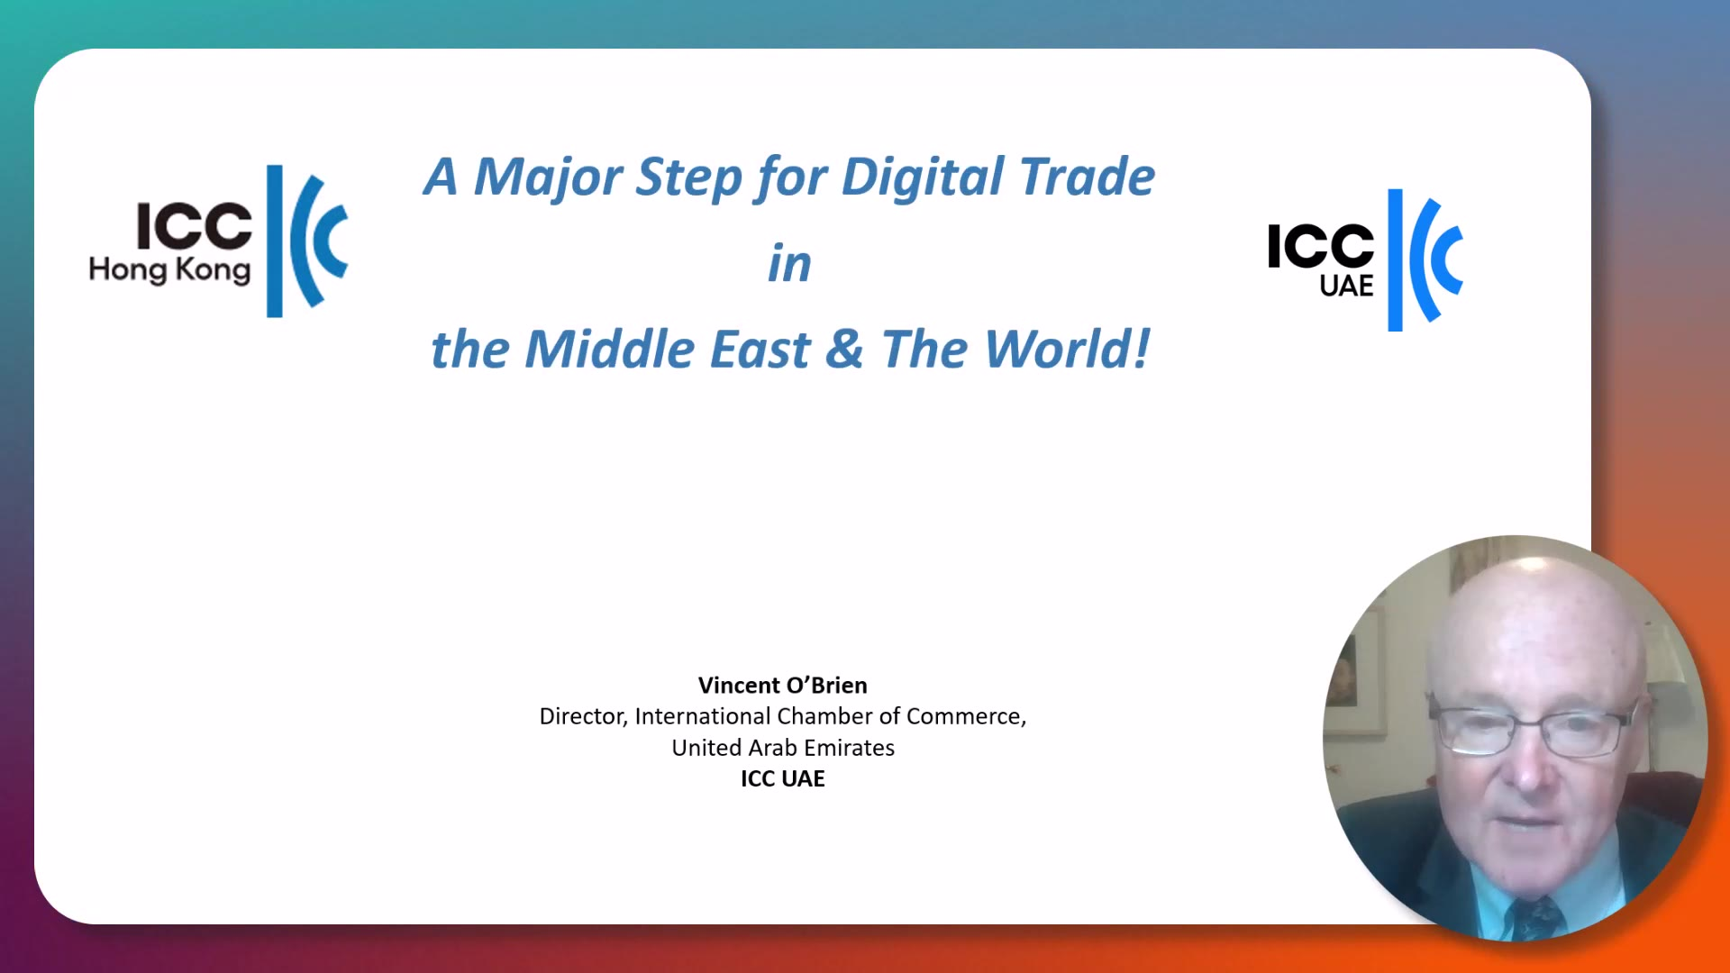
OPENING BRIEFING · RECORDED FOR ICC HONG KONG
Three to One, Then None: Vincent O'Brien, Director, ICC UAE
Recorded for ICC Hong Kong and ICAEW Hong Kong · 11 minutes
Notes:
STACY: welcome, housekeeping (CPD attendance, Q&A box, recording), introduce Michael, then hand to Vincent's video.
MICHAEL: before clicking play, confirm Zoom 'Share sound' and 'Optimise for video clip' are ticked. Click the video once. Runtime 11:03.
Backup: if playback stutters, stop sharing and play the MP4 directly from the desktop with sound shared, or Stacy plays it from her machine.
When the video ends, advance to the title slide and open with the speaker-change line in its notes.

Slide 2
ICCHK SERIES · ICAEW HONG KONG · PBEC
GCC Development Outlook
& Digital Trade in the Middle East
Seven months of disruption: impact on cost, demand and critical issues.
Michael Walsh MD PBEC & ICC HK – Content acknowledgement Vincent O’Brien ICC UAE
Tuesday 22 September 2026 · 12:00–13:00 HKT · 1 hour CPD
Notes:
Open here straight after Vincent's video. One line on the speaker change: Vincent has been caught by a flight schedule change, so he recorded the briefing and I will take you through the wider regional picture. Then say the hour hangs on three board questions, which come up on slide 5.

Slide 3

ICC UAE DIGITAL TRADE FORUM · DUBAI CHAMBERS · 3 SEPTEMBER 2026
Three-to-One Then to None
3
1
0
Paper originals
Electronic original
No paper at all
Today's practice.
Three negotiable originals, couriered between shipper,
bank and consignee.
One authoritative electronic record replaces the multiple negotiable originals.
Control, transfer and financing handled digitally under a trusted legal framework.
A staged migration for banks, carriers, forwarders and regulators: deliberately not a big-bang switch.
Forum led by ICC UAE Director Vincent O'Brien, hosted by Dubai Chambers. Source: Documentary Credit World, 16 Sep 2026.
2
Notes:
This is the slogan behind the initiative Vincent has just described. Say the progression out loud: three paper originals, then one electronic original, then none. The point for this audience is the middle step. One authoritative record is what lets a bank release funds without waiting for coloured paper to arrive by courier.

Slide 4
WHY THREE ORIGINALS SURVIVED
Shipping says
Banking says
Three must be issued, because the banks require a full set of three originals.
Three must be required, because the carriers issue a set of three originals.
Neither rule requires it. UCP 600 Article 20(a) already permits a single original bill of lading.
Source: Vincent O'Brien, "Single Original Bill of Lading Reform", Documentary Credit World, 12 Aug 2026.
3
Notes:
This is the heart of Vincent's argument and worth pausing on. The three-original convention is not required by the UCP, by carriers or by banks. Each side believes the other requires it, and the practice survives on that assumption alone. That is why the reform starts at three-to-one rather than jumping to zero: the first step needs no new law and no new technology, only a decision. The move to none is the part that needs MLETR-aligned law, which is where Hong Kong comes in on the next slide.

Slide 5
State of Electronic Bills of Lading
Electronic bills of lading in banking
Where Hong Kong law stands
Awareness — 82.5%
When | What happens
Dec 2025 | Consultation opens on amending the Electronic Transactions Ordinance
Mar 2026 | Consultation closes
May 2026 | Mainland's amended Maritime Code takes effect
2027–2036 | Est. HK$34.9bn net industry savings once digitalised
Adoption — 21.1%
Terminals and carriers are already above 73%. The gap sits where the money moves.
Cross-border gap: the proposal does not yet cover records recognised under other jurisdictions' laws.
Sources: ICC UAE / FIT Alliance eBL survey; HK Commerce and Economic Development Bureau, Apr 2026.
4
Notes:
This is the accountant's slide. High awareness with low adoption is a controls problem, not a technology problem. Flag three practical consequences: audit evidence for goods in transit changes; controls over title documents change; and duplicate-document fraud risk falls when there is one authoritative record. Then note that Hong Kong law is mid-process, so contracts and bank mandates should be reviewed now, not after the amendment passes.

Slide 6
28 FEBRUARY – 17 SEPTEMBER 2026
Key Facts and Figures
$105.83
1.3%
−90.1%
Brent, 16 September close
GCC growth forecast, 2026
Jebel Ali volumes, Q2
About $72 before the war; peaked at $119
World Bank, cut from 4.4%
374k TEU against 3.8m a year earlier
−29%
−$4.3bn
25%
Dubai hotel occupancy
Middle East airlines, 2026
China export growth, August
Jan–Jul, year on year; UAE as a whole −26%
IATA forecast, from +$7.2bn in 2025
The shock is regional, not global
Sources: CNBC; World Bank via The Conversation; DP World H1 2026; Cavendish Maxwell via AGBI; IATA; China customs via AP.
5
Notes:
Land the last tile hardest. China's exports grew 25 per cent in August and the trade surplus hit a record, so this is not a global demand collapse. It is a regional shock that lands unevenly. That distinction is what stops a board over-correcting. Steel exports to the Middle East nearly halved, but semiconductors and autos surged into other markets.

Slide 7
THE REST OF THIS HOUR
Three Critical Issues
01
02
03
Exposure and cost
Durability
Triggers
Where are we exposed, and who is really absorbing the extra cost?
Is the performance we are looking at real, or propped up?
What will we do, and when will we know to do it?
Us, our customers, our suppliers, a government, or an investor.
Hedges, state relief, pass-through revenue and loss-leader spending all expire.
Named signals beat a forecast nobody can make.
6
Notes:
Say these are the three questions to take back, and that every remaining slide answers one of them. Invite the audience to note which of the three their own organisation answers least well. That becomes the closing poll.

Slide 8
QUESTION 01 · EXPOSURE AND COST
Layer | H1 2026 evidence | Who absorbed it
Carriers | Maersk fuel surcharge set at a minimum 15% of the rate | Passed straight on
Forwarders | Aramex H1 revenue AED 3.43bn, up 12%; EBIT margin 4.1% | Revenue up, margin thin — charters passed through
Ports | DP World H1 revenue $12.7bn, up 13.1%; adjusted EBITDA down 5.6% | Network absorbed the Jebel Ali hit
Platforms | talabat H1 GMV $5.6bn, up 15%; Q2 net income down 18% | Shareholders, by choice
Consumers | Temu Gulf delivery estimates stretched from about 15 to 20 days | Paid in service, not yet in price
Ask the question about your own chain: revenue growth that is really recovered surcharge is not growth.
Sources: Maersk operational updates; Aramex H1 2026; DP World H1 2026; talabat H1 2026; Bloomberg.
7
Notes:
Work down the rows. The cost starts as a carrier surcharge, moves into forwarder revenue without much margin, gets absorbed by diversified networks, and then gets taken deliberately by platforms buying share. Consumers have mostly paid in slower service rather than higher prices, which is why the pressure has not shown up in headline inflation the way boards expected. For the accountants: this is the difference between pass-through revenue and underlying growth, and it belongs in the MD&A.

Slide 9
QUESTION 02 · DURABILITY
Benchmark | The headline | What is holding it up
Emirates Group | Record AED 24.4bn pre-tax profit, year to 31 Mar 2026 | Hedged to 2028–29; only one war month fell in the year
Emirates SkyCargo | Passenger flying back near 100% by mid-July; six freighters added since March | Capacity ordered before the war; no 2026 state injection disclosed
Cathay Pacific | H1 profit up 71% to HK$6.24bn | Europe traffic rerouted via Hong Kong; Gulf routes still suspended to 30 Nov
Keeta (Meituan) | Profitable in Saudi Arabia in 22 months | Parent-funded entry; industry subsidies still above 2024 levels
Dubai hospitality | Still trading through a 29% occupancy fall | AED 2.5bn of state relief: fees deferred, hotel taxes suspended
The counter-example: airBaltic was unhedged, and filed for Chapter 11 on 14 September.
Sources: Emirates Group 2025–26 report; Air Cargo News; SCMP; Meituan Q2 2026; Dubai Executive Council; Reuters.
8
Notes:
Be careful with the subsidy point. No 2026 capital injection into Emirates has been disclosed, so put it as a question rather than a claim. What is visible is a fuel hedge running to 2028-29 and a state that has backed the airline before, with AED 11.3bn in 2020. The real test is the half-year to September, due around November. The wider lesson is the one in the last line: the same fuel price destroyed an unhedged carrier and barely touched a hedged one.

Slide 10
QUESTION 03 · TRIGGERS
Six Signals
Strait of Hormuz transit
Qatar force majeure
Largely blocked since 28 February
Renewed monthly since March
The single biggest swing factor for freight cost and transit time
Drives input costs for Asian manufacturing and fertiliser
East-West pipeline
Gulf airline capacity
Shut 11 September; weeks, not days
Cathay's Gulf routes suspended to 30 Nov
The last bypass around Hormuz; restart is the near-term price signal
Route restoration runs ahead of trade and travel normalising
Brent crude
Gulf hotel occupancy
$105.83 on 16 September
UAE down 26% for January to July
Every $10 reaches freight and fuel surcharges within weeks
The cleanest proxy for MICE, retail and corporate travel demand
Readings as at 17 September 2026. Sources: CNBC; Doha News; SCMP; Cavendish Maxwell via AGBI.
9
Notes:
The argument here: nobody in this call can forecast when demand returns, so stop trying. Put these six readings in the monthly board pack with a pre-agreed action against each. That converts an unanswerable forecasting question into a monitoring routine the finance function can actually run.

Slide 11
2027 PLANNING
Three Possible Scenarios
Scenario | The signal | Effect on cost | Pre-agreed action
Settlement | Hormuz reopens; pipeline restarts | Surcharges unwind over two to three quarters | Restore Gulf capacity in stages; renegotiate surcharge floors down
Stalemate | Escorted corridors; risk premiums persist | Structurally higher freight, fuel and insurance | Keep dual routing; price surcharges into contracts; hold liquidity headroom
Escalation | Red Sea and bypass routes both constrained | Step change in landed cost; demand falls again | Shift sourcing and markets; defer Gulf capex; stress-test counterparties
The IMF puts the cumulative Gulf output loss at 7% over five years. Plan for a slow recovery, not a snap-back.
Source: IMF via Stimson Center, May 2026. Scenarios are planning constructs, not forecasts.
10
Notes:
Do not put probabilities on these. The value is in the last column: the actions are agreed now, while nobody is under pressure, and the triggers on the previous slide tell you which column you are in. Note that reopened airspace has not restored old travel patterns, so the settlement column still assumes a lag between capacity returning and demand returning.

Slide 12
Key Takeaways
01
Separate pass-through surcharge revenue from underlying growth in your reporting.
02
Test counterparties on funding, not revenue.
Ask what expires: the hedge, the relief, or the investor's patience.
03
Run the December year-end checklist now: going concern, HKAS 36, HKFRS 9, goods in transit, onerous contracts.
04
Ask your banks and forwarders today whether they will accept a single original, and then an electronic one.
Diversify markets with credit discipline.
Africa and Central Asia carry FX and payment risk the Gulf does not.
05
Thank you. Questions welcome — and this session carries 1 hour of CPD.
11
Notes:
Close by restating the three questions rather than the content: who absorbs our cost, is what we are looking at real, and what will we do and when. Then run the closing poll on which of the three their organisation answers least well, and open Q&A with whatever the poll shows.

